Slide 1
Covid 19 Sentiment analysis using VADER and Textblob
Mod 9.2 Presentation
Lim Zheng Wei

Slide 2
COntents
1. Web Scraping/Load Data
2. Clean Text
3. NER
4. Sentiment Analysis
5. Visualisations/Analysis/Comments

Slide 3
Intro
Objective: See how sentiment varies between countries and over a period of time
Scope: Use VADER and TextBlob to find out sentiment score
We will find articles across the past 2 weeks (23 Aug-5 Sep)
Comparing Singapore, UK and US

Slide 4
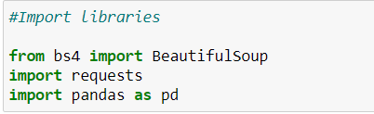
1. Web Scraping
https://medium.com/@lzpdatascience/web-scraping-and-text-summarization-of-news-articles-using-python-2ecfb3e71050
Or use Eric’s demo on Text Data Collection

Slide 5
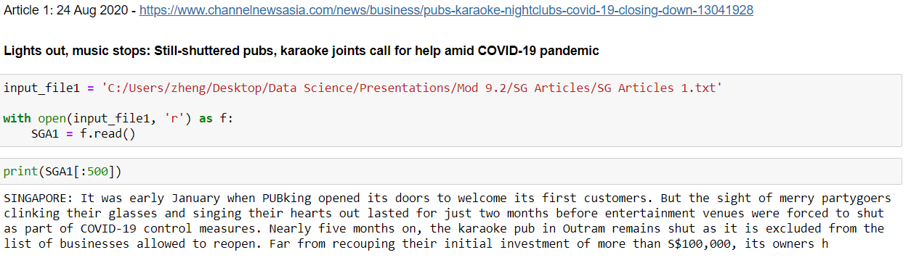

Slide 6
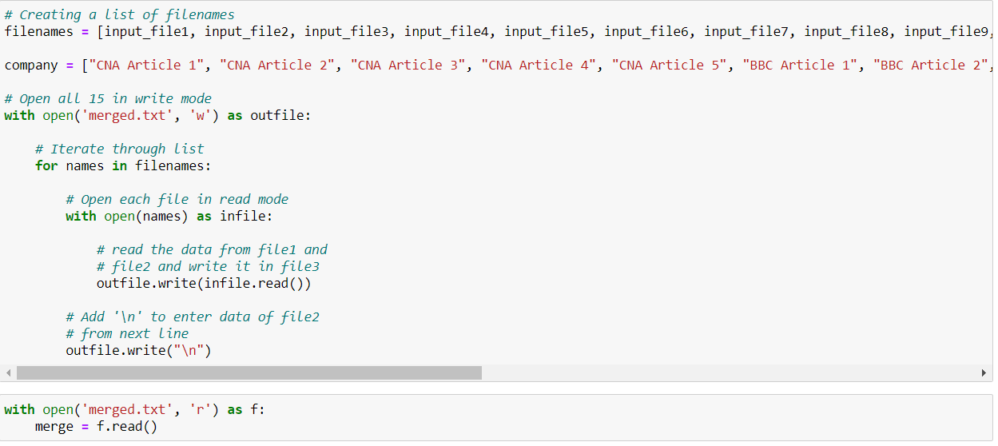
Merge them all

Slide 7
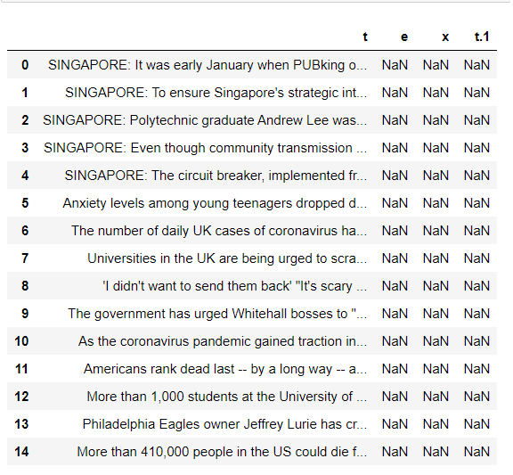
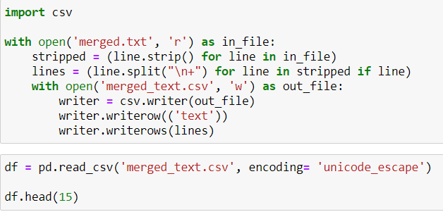
Convert to dataframe

Slide 8
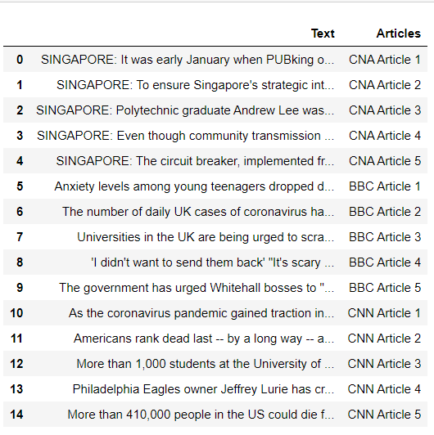
df = df.drop(columns=['e','x', 't.1'])
df = df.rename(columns={'t':'Text'})
df['Articles'] = company

Slide 9
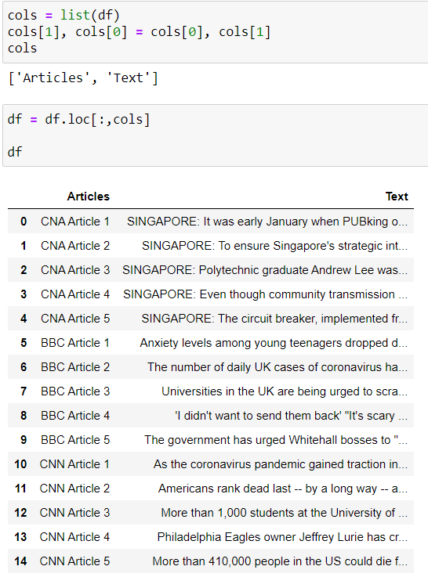

Slide 10
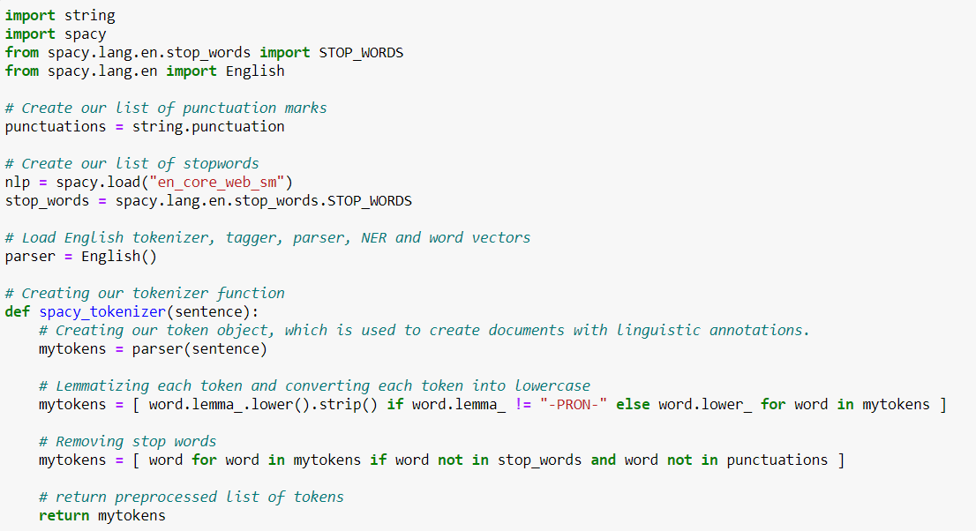
2. Clean text

Slide 11
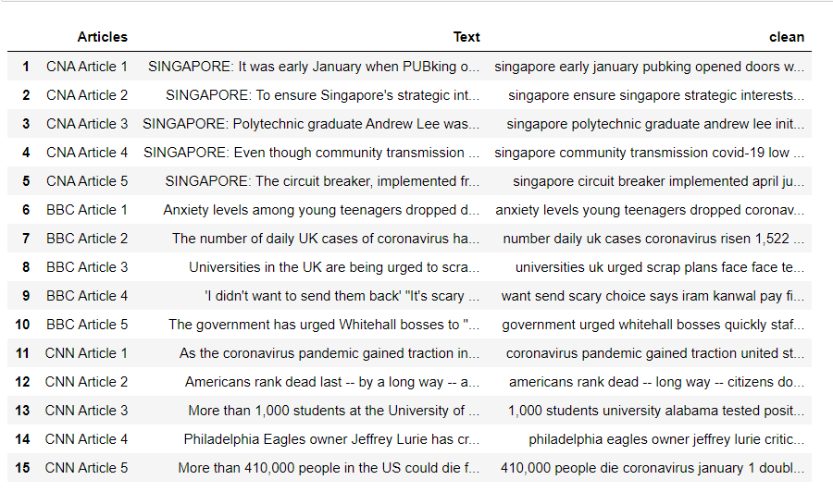
df['clean'] = df['Text'].apply(spacy_tokenizer)
df['clean'] = df['clean'].apply(lambda x: " ".join([str(word) for word in x]))

Slide 12
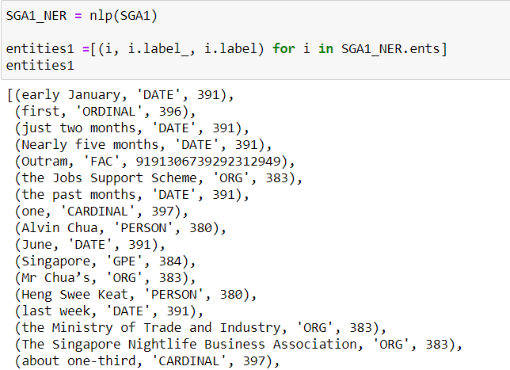
3. Named Entity Recognition(NER)
NER is a form of information extraction
Classify names based on categories e.g person, organisation

Slide 13
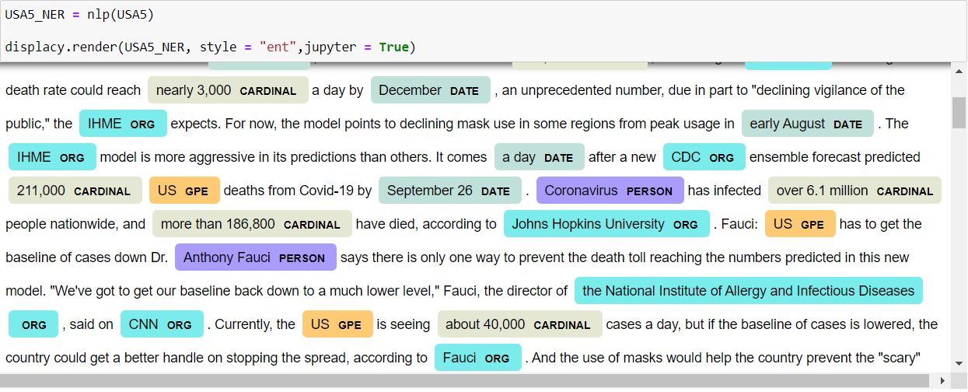
from spacy import displacy

Slide 14
4A. Sentiment analysis - VADER
VADER (Valence Aware Dictionary and sEntiment Reasoner) is a lexicon and rule-based sentiment analysis tool that is specifically attuned to sentiments expressed in social media. VADER uses a combination of A sentiment lexicon is a list of lexical features (e.g., words) which are generally labelled according to their semantic orientation as either positive or negative.

Slide 15
Why use vader?
It works exceedingly well on social media type text, yet readily generalizes to multiple domains
It doesn’t require any training data but is constructed from a generalizable, valence-based, human-curated gold standard sentiment lexicon
It is fast enough to be used online with streaming data, and
It does not severely suffer from a speed-performance tradeoff.

Slide 16
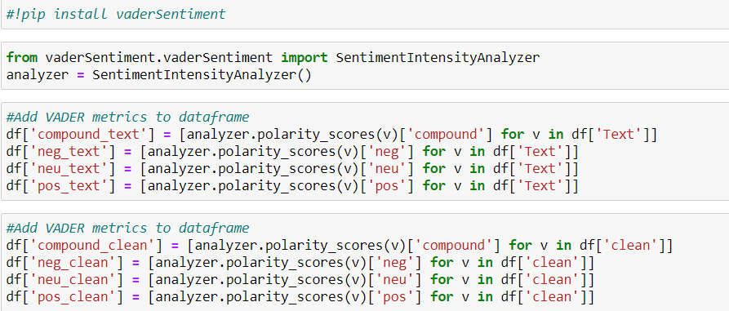

Slide 17
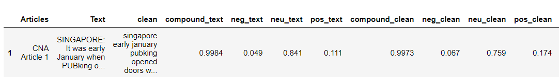
Scoring system
The Positive, Negative and Neutral scores represent the proportion of text that falls in these categories. This means our sentence was rated as 11.1% Positive, 84.1% Neutral and 4.9% Negative. Hence all these should add up to 1.
The Compound score is a metric that calculates the sum of all the lexicon ratings which have been normalized between -1(most extreme negative) and +1 (most extreme positive).

Slide 18
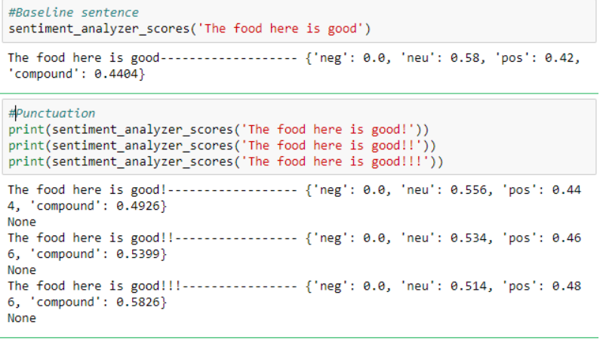
VADER scoring metrics
1. Punctuation: The use of an exclamation mark(!), increases the magnitude of the intensity without modifying the semantic orientation. For example, “The food here is good!” is more intense than “The food here is good.” and an increase in the number of (!), increases the magnitude accordingly.

Slide 19
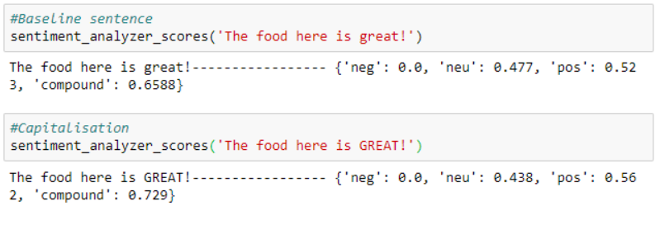
2. Capitalization: Using upper case letters to emphasize a sentiment-relevant word in the presence of other non-capitalized words, increases the magnitude of the sentiment intensity. For example, “The food here is GREAT!” conveys more intensity than “The food here is great!”

Slide 20
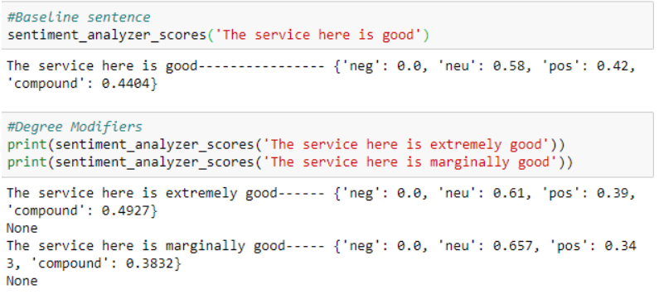
3. Degree modifiers: Also called intensifiers, they impact the sentiment intensity by either increasing or decreasing the intensity. For example, “The service here is extremely good” is more intense than “The service here is good”, whereas “The service here is marginally good” reduces the intensity.

Slide 21
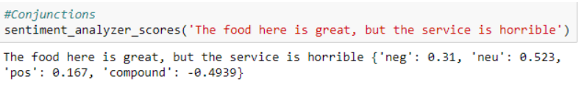
4. Conjunctions: Use of conjunctions like “but” signals a shift in sentiment polarity, with the sentiment of the text following the conjunction being dominant. “The food here is great, but the service is horrible” has mixed sentiment, with the latter half dictating the overall rating.

Slide 22
5. Preceding Tri-gram: By examining the tri-gram preceding a sentiment-laden lexical feature, we catch nearly 90% of cases where negation flips the polarity of the text. A negated sentence would be “The food here isn’t really all that great”.

Slide 23
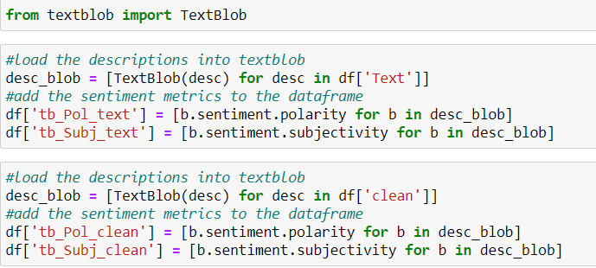
4b. Sentiment analysis - textblob
Returns in the form of Sentiment(polarity, subjectivity)
Polarity score : Range between -1.0 and 1.0
Subjectivity score : Range between 0.0 and 1.0 where 0.0 is very objective and 1.0 is very subjective.

Slide 24
5. visualisation
A. Compare a country over a 2 week span
B. Compare the 3 countries at a specific period of time

Slide 25
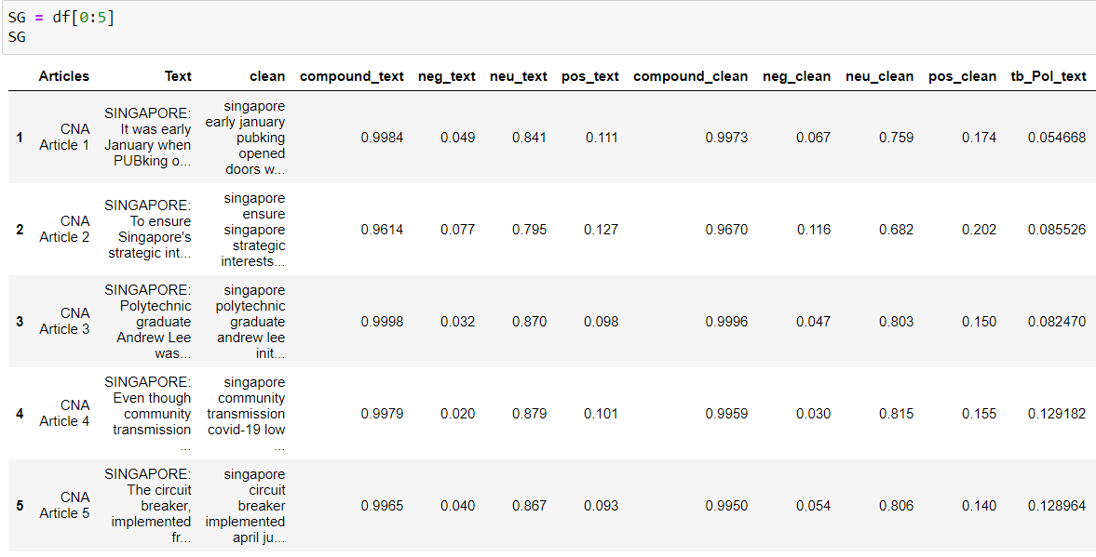
5A

Slide 26
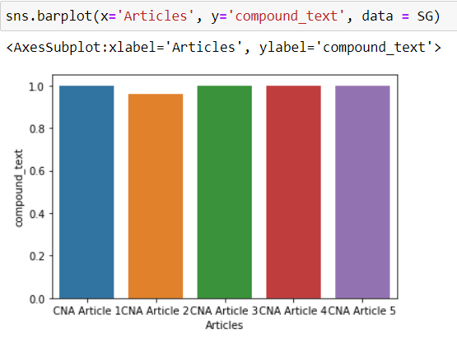
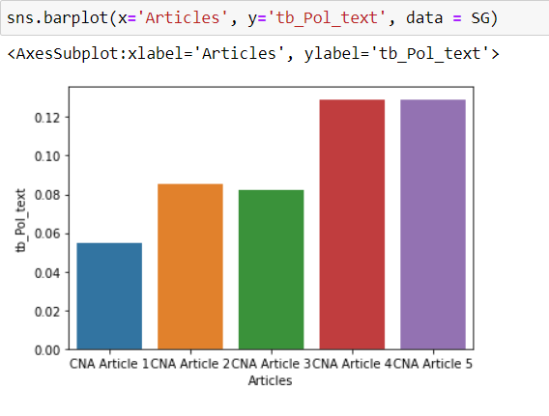
SG - Overall sentiment

Slide 27
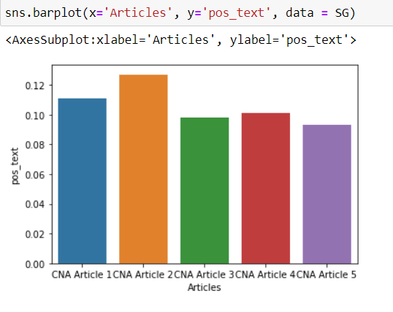
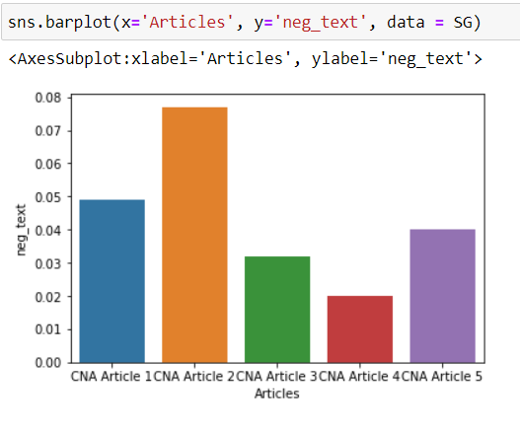
Breakdown

Slide 28
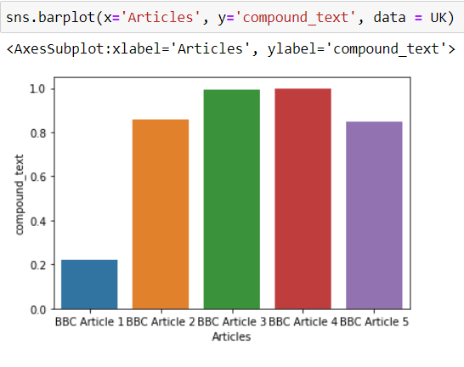
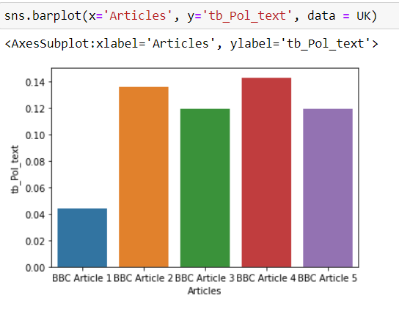
UK – Overall sentiment

Slide 29
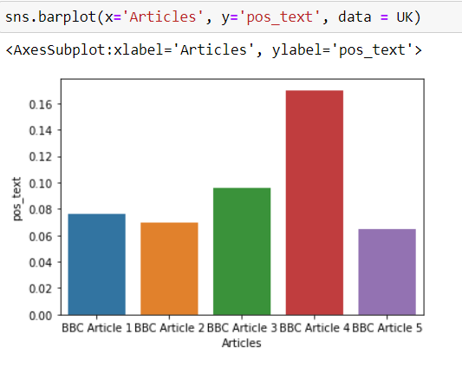
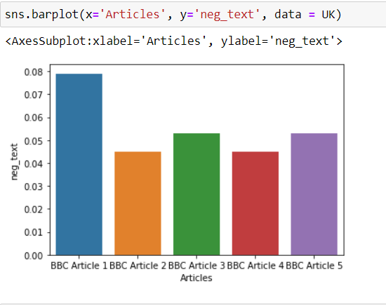
Breakdown

Slide 30
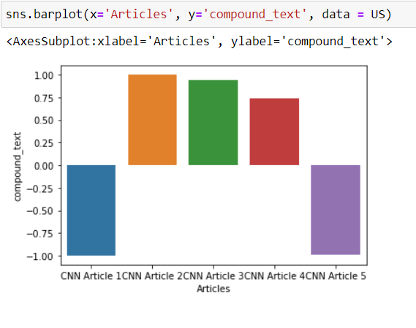
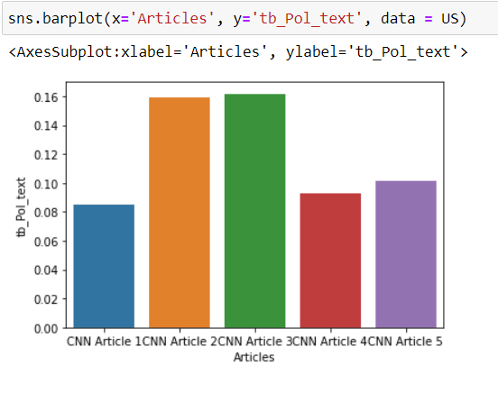
USA – Overall sentiment

Slide 31
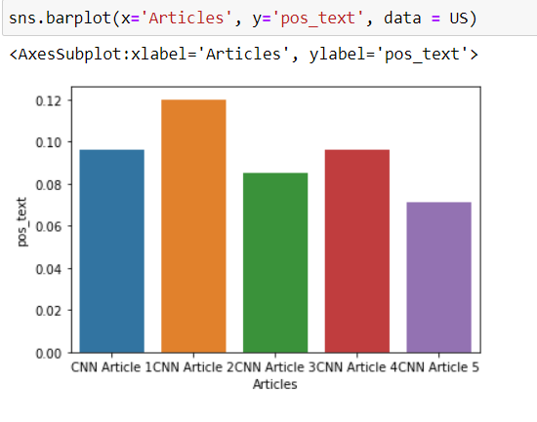
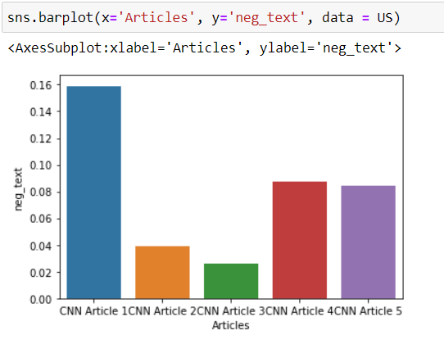
Breakdown

Slide 32
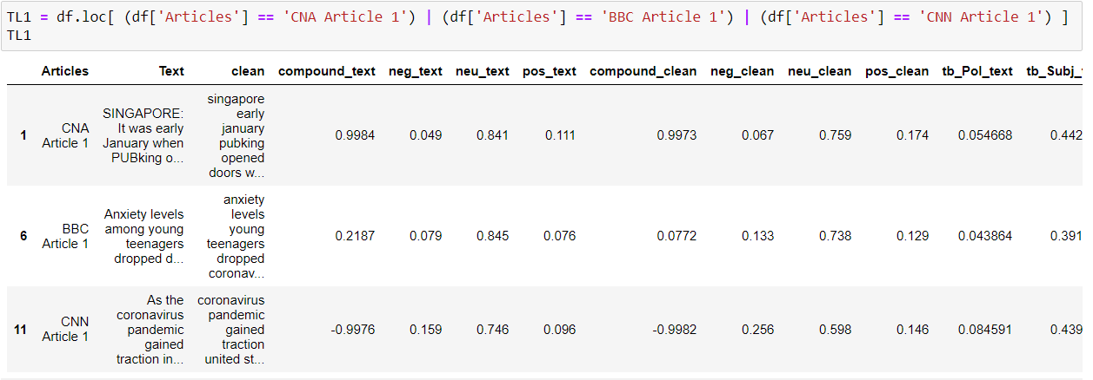
5B

Slide 33
Overall sentiment

Slide 34
polarity score

Slide 35
Positive text

Slide 36
Negative text

Slide 37
observation
No need to clean text for sentiment analysis
Excel can compliment with Python
Can consider doing 5B in Time Series

Slide 38
conclusion
All 3 countries are slightly feeling positive about covid-19
US has spells feeling negative
Shows importance of good governance, how the public feels about the measures
The impacts of covid-19 are real
Take care everybody
Stay safe, wear a mask when going outdoors

Slide 39
References
https://medium.com/analytics-vidhya/simplifying-social-media-sentiment-analysis-using-vader-in-python-f9e6ec6fc52f

